Slide 1

The Imperial Management
HOTEL APPLICATION
Krishal, Sanjit and Cara
Notes:
Krish

Slide 2
SCOPE To create an Android Application for Housekeepers, Management and Front Desk staff within the Accommodation Industry to use in order to lessen time used to report a room status. Aim To create order and reduce loss of time for Housekeepers and Management within the Accommodation Industry. Objectives 1] Research current methods used within the Accommodation Industry in respect to room maintenance. 2] Design, create and test an Android Application. 4] Design and create a database.
Notes:
Krish

Slide 3
MOVs 1] OPERATIONAL IMPACT – Our applications will make communication faster for the Housekeepers and Front Desk staff as it will allow communication in both directions to be done in real-time, without them having to travel to find the person(s) they wish to report to. 2] CUSTOMER- Our aim is to get our application to at lest 20 to 40 accommodation providers in Manukau area as there are about 70-75 motels in this region alone hence why we are looking to approach local providers and then reach out in to the larger market as this will provide with hands on testing in the real market and allow use to amend any bugs in the system. We anticipate to getting 150 members within the first year of launch in to the market. This will be done through advertising through emails to companies and also through arranged meetings with either the owner and or the manager.
Notes:
Krish

Slide 4
3] FINANCE- From the research we have conducted we found that there are many companies providing same to similar software's to businesses however they are generally to large companies such as hotels and hence charging more for the systems, its subscription based and they charge about $200NZD per month to $350NZD per month . This is why most of the small accommodation are unable to have this system, agree that those systems have more functionalities but its not needed in motel setting, hence we have come up with a low figure of $99NZD per month per site, as our application would be simple and just around housekeeping management only if we can then in the near future we can expand this and add more functionalities if we can ensure it doesn’t affect pricing too much.
Notes:
Krish

Slide 5
EXISTING SYSTEMS HOTELFRIEND- Hotel friend provides multiple management application such as hotel management system, central reservation system, property management system, and software for small hotels. 1.Deal, package composer, mobile concierge app. 2.Hotel guestbook mobile app, room service mobile app and also hotel website development. 3.Applications.
Notes:
Krish

Slide 6
EXISTING SYSTEMS KNOWCROSS- Know housekeeping does also provide easy to use application on android and IOS devices hence making it much easier to the user built into the application has options to select multilanguage interface to reduce language barrier. This application also can contacts to your PMS therefore the front desk will be aware of rooms which are dirty, clean, inspected. Know housekeeping applications automatically allocated rooms and will prioritization rooms depending on guest requests of early check-in. Know housekeeping will also look at your linen count and will report to front desk to order more linen and will calculate depending on how many check out of how much linen is required.
Notes:
Krish

Slide 7
EXISTING SYSTEMS eZee Front Desk – App is mainly used by small lodge, hotel and motel and company claim that app is using in 140 countries all around the world and more than 1 million transaction in a day and across hotel management property resulting in 90,000 room manged and 70,500 users by ezee front desk app. 1.Receive application report on phone and tablets. 2.Event management. 3.Self-service check in kiosk. what we would like to improve or add in the future for our system 1.We could add any language pack based on client majority. 2.Online help.
Notes:
Sanjit

Slide 8
EXISTING SYSTEMS Cloud beds Reservation System – This app is multi task that can connect to hundreds of channels from your property such as booking.com and Orbitz and it allow guests to make direct booking from their desktop, phone and through Facebook so, this app so handy and gives good impact for small business e.g. - hotel and motel. 1.Easy to use and 24/7. 2.Customer support online. 3.Credit card system integrated by third parties. what we would like to improve or add in the future for our system. 1.Online support 2.We would add payment from credit card in the future.
Notes:
Sanjit

Slide 9
RISKS AND MITIGATION Lack of Experience and SKILLS- Lack of experienced our team has only one software developer and required to create a hotel reservation app its big job for us as a team to produce app and that’s going to be challenging. we simply lack expertise but we both networking student will try our best to help our developer out during these 8 weeks to make efficient app for our staff. Mitigation- Discussion with senior software developer and learning from them, what need to be done on time as of knowledge side it doesn’t matter who’s is younger or older it all about asking and doing own research putting effort so, i think if developer could do that it would be another chance to gain some more experience and adding skills.
Notes:
Sanjit

Slide 10
RISKS AND MITIGATION Technology FAILURE- If technology is failing could put huge failure impact on project as we all know system could be fail at any time and that cause a massive loss to our group through technology as technology has number of good reason but never know what could have happened to machine in couple of second because all work is going to be save on our computer. Mitigation- All we can do to have a backup on a different computer at the same while doing a project that’s the only way we could save our work or on google drive.
Notes:
Sanjit

Slide 11
RISKS AND MITIGATION Miscommunication- Bad communication is the biggest thing especially when doing a project work with different members as we all know need to know what the task are of another member. Improper communication could lead to fail project or assignment and give unnecessary problem that we don’t want especially, when you have only 8 weeks to create an app so, communication must be good between members. Mitigation- Having meeting with your group members exclude class meeting trying to make a time for them and that would help everyone to lead successful project
Notes:
Sanjit

Slide 12
RISKS AND MITIGATION Time- Our group is very inexperienced regards of creating a hotel reservation app for our group and only have 8 weeks to do so. we could be fall behind in this project due to lack of experience and we never done like this before so, it’s so new for us that could reach failure to reach our milestone or could be fail the project. Mitigation- Its important that we distribute our task between members so, everyone has fair chance to do during time given as time is super crucial for this project because nobody want to fail this course so, every single member need to use time very efficiently to have nice impact on our project.
Notes:
Sanjit

Slide 13
METHODOLOGY
AGILE
We have limited time
Require flexibility to change parts of our project as it goes through development.
This means we will have our product owner (supervisor in this case), work closely with us - the team - to prioritize what needs to be accomplished in the next ‘sprint’ (Blueprint, n.d.).
Notes:
Cara

Slide 14
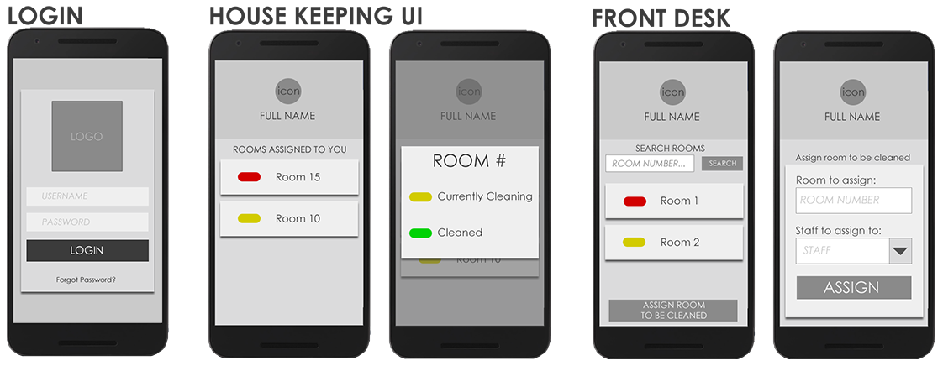
DESIGN UI
Notes:
Cara

Slide 15
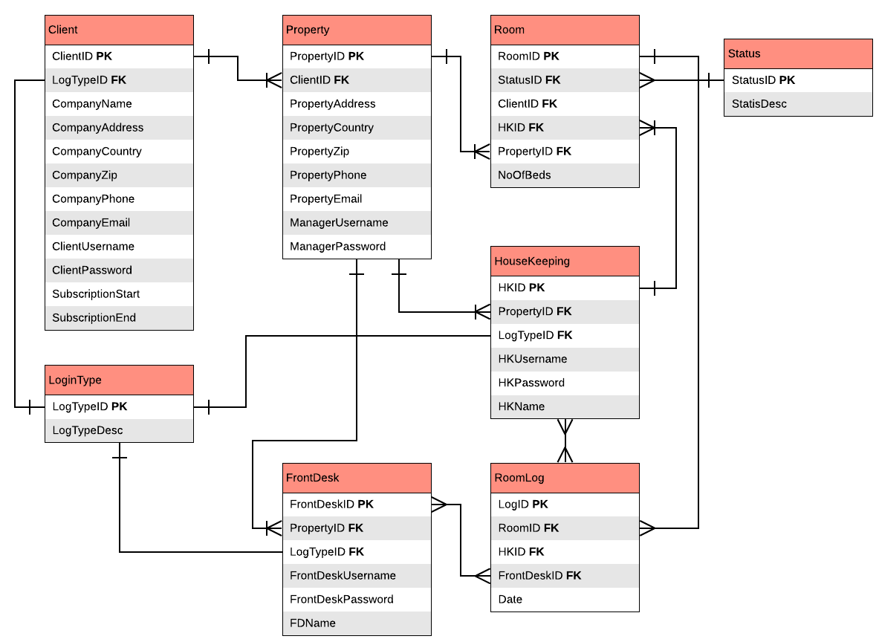
ERD
Notes:
Cara

Slide 16
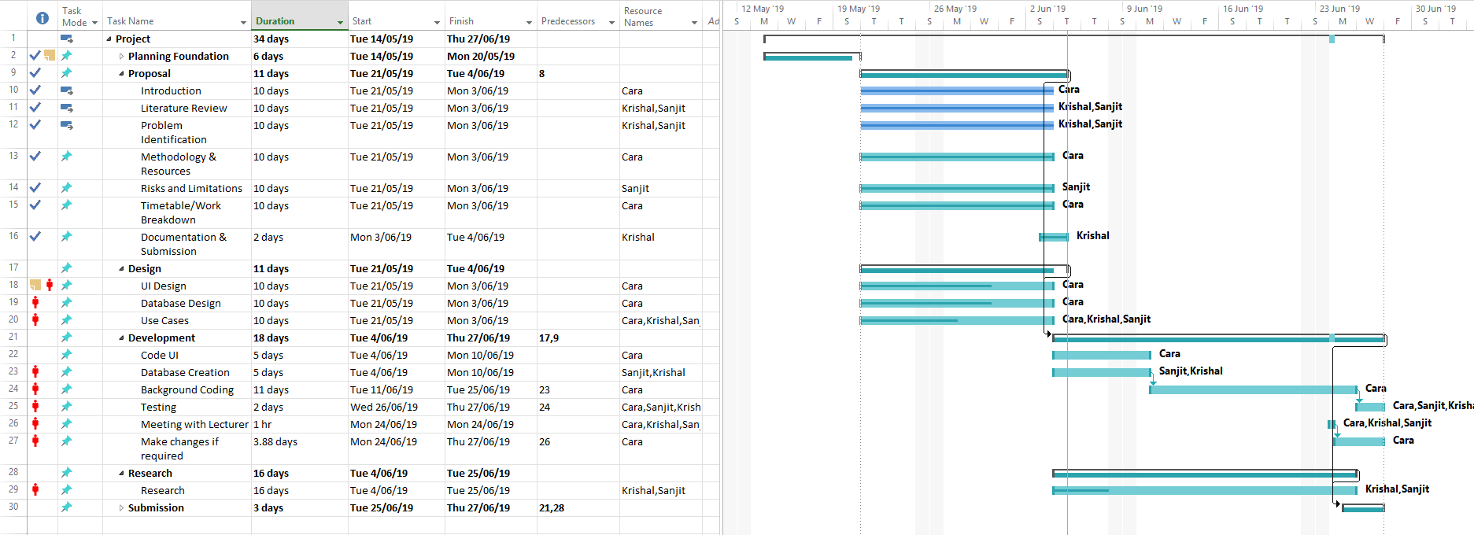
GANTT CHART
Notes:
Cara

Slide 17
REFERENCES
Blueprint. (n.d.). Agile Methodologies. Retrieved from
https://www.blueprintsys.com/agile-development-101/agile-methodologies
HIBOX. (2019). HI box. Retrieved 30/05/2019, from https://www.hibox.tv/Hotel-Housekeeping-System.shtml
HotelFriend AG. (2019). About US . Retrieved from HotelFriend: https://hotelfriend.com
Ivanović, S. &. (2008). HUMAN RESOURCE MANAGEMENT IN THE HOSPITALITY INDUSTRY. Croatia.
Knowcross. (2019). About Us. Retrieved 2019, from KnowCross: https://knowcross.com/
Taylor, D. (2018, Jan 2nd). The 11 Most Popular Hotel Management Software Solutions for Small Hotels Compared. Retrieved from Capterra: https://blog.capterra.com/the-5-most-popular-hotel-management-software-solutions-for-small-hotels-compared/
USA, c. C.-(.-1. (2012). Cloudbeds. Retrieved from Capterra: https://www.capterra.com/p/158839/Cloudbeds/
Notes:
Cara

Slide 18

Thank you
Notes:
Cara

